Slide 1
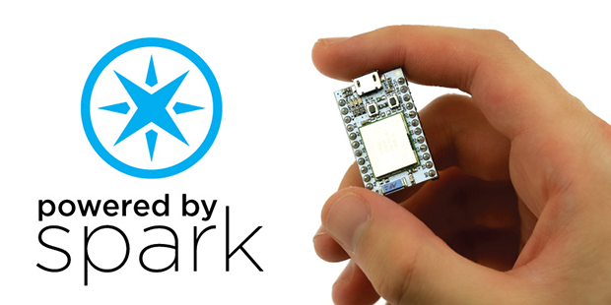
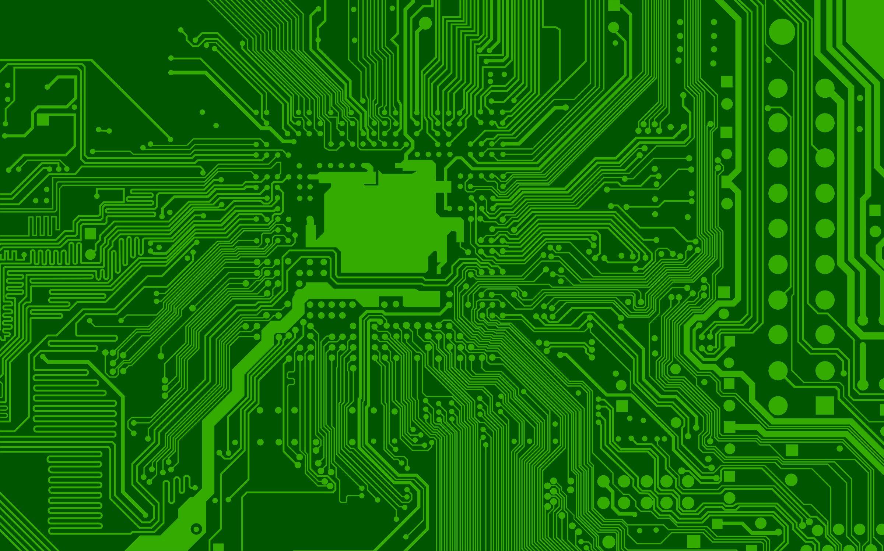
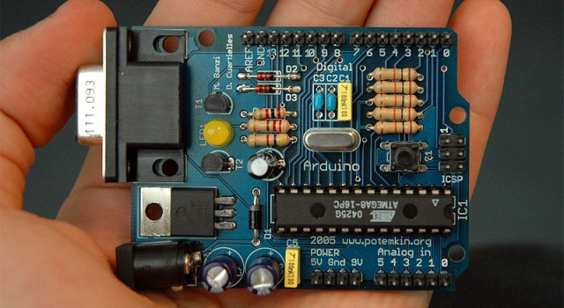
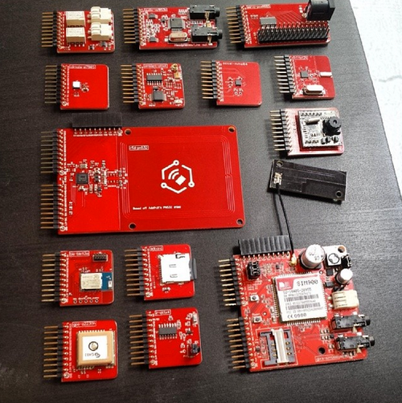
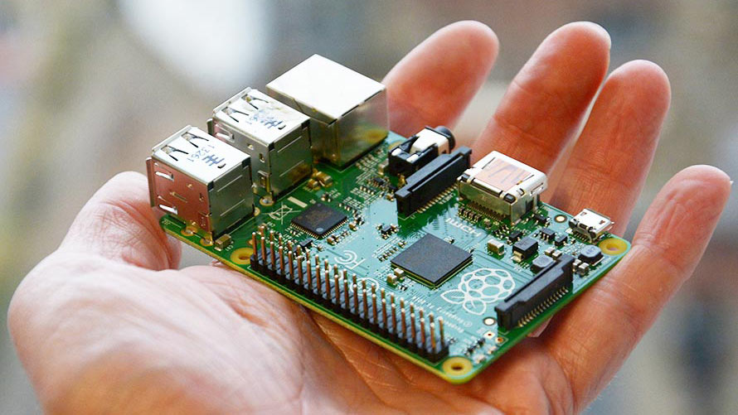
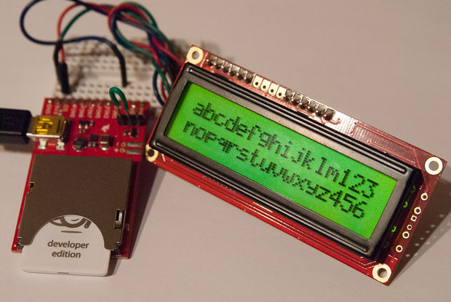




Internet of Things

Slide 2
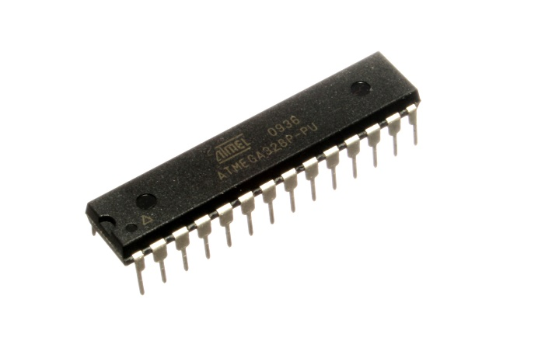
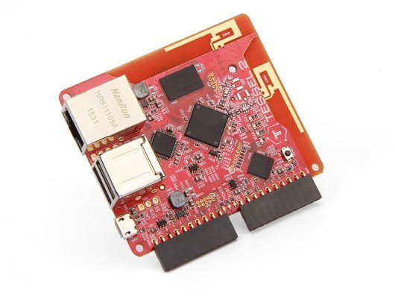

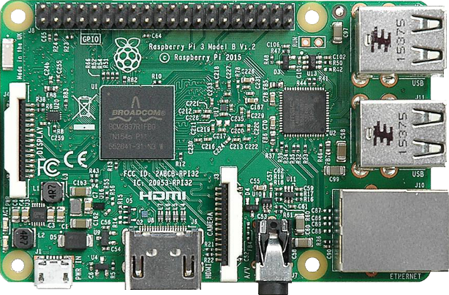
The Microcontroller Spectrum
Application Specific
Prototype
General Purpose
Atmega328
Requires approx. 10% of Arduino hardware to function
Arduino compatible programming
Arduino
Atmega328
All support hardware included
USB programming
Power regulation
Pins “Broken out”
C-like programming language
Tessel
RISC based
Includes WIFI and Ethernet
Javascript based (NodeJS)
Pins “Broken out”
Raspbery Pi
A fully functioning computer(!)
Pins “broken out”

Slide 3
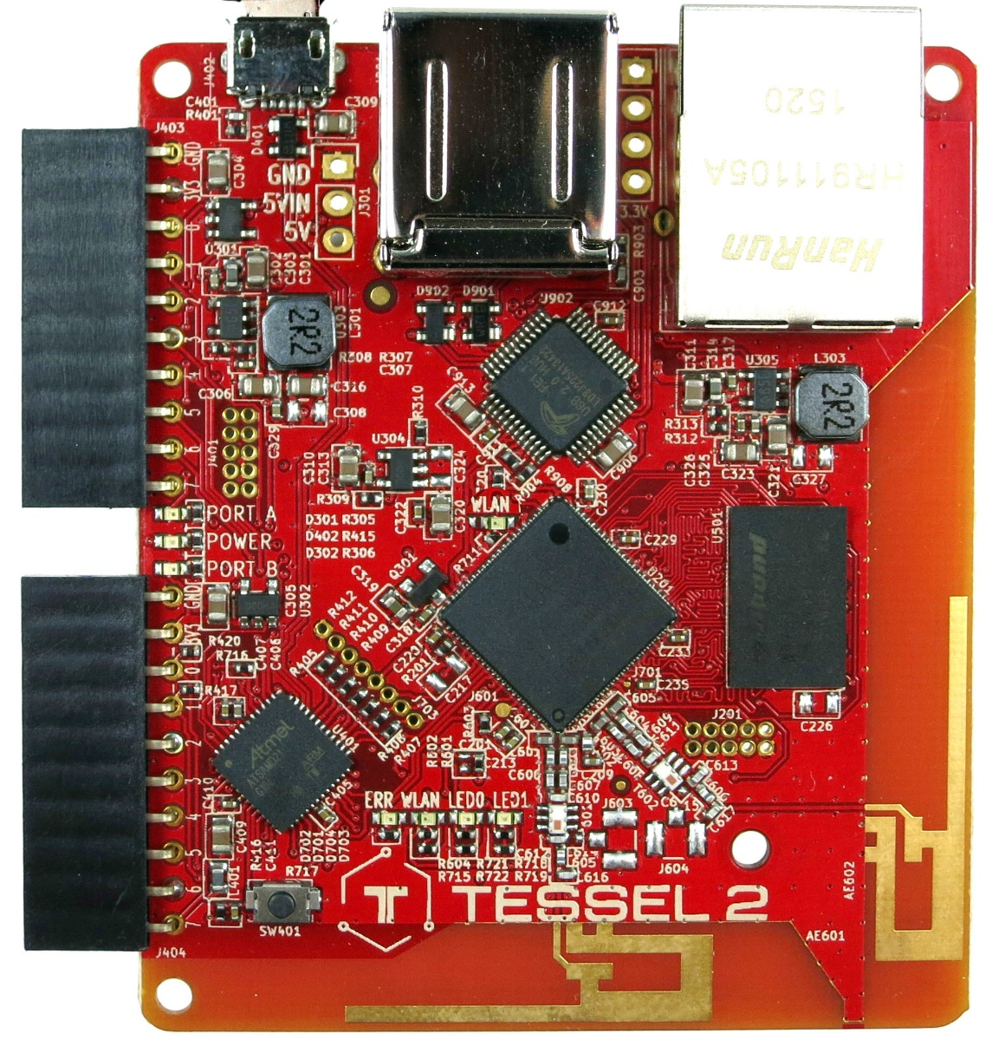
Tessel runs Javascript
MicroUSB and Regular USB for power and/or programming
Ethernet for network, can also provide power
IO Pins
WiFi Antenna

Slide 4
Why Tessel?
WiFi + Javascript

Slide 5
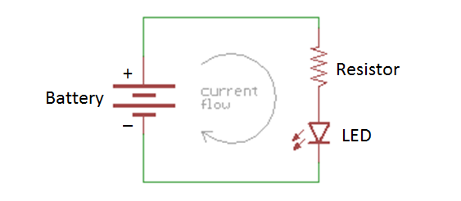
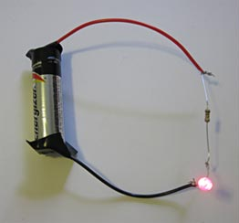
Example: LEDs
The resistor provides resistance which changes the current (V=IR)
The Battery provides current at fixed voltage
The brightness of the LED is determined by how much current is supplied

Slide 6
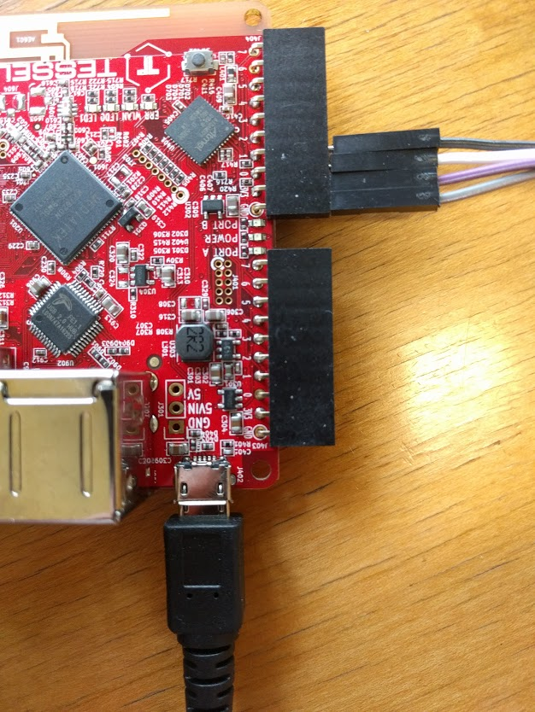
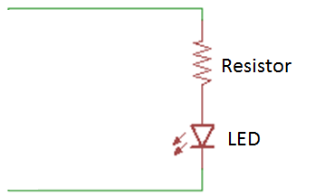
Example: LEDs
In the initial example, the battery simply provides a constant voltage, driving a current in the circuit. If the battery is flat, the voltage (or Potential) at + and - is 0V, so no current flows. For current flow the potential at + must by higher than at –.
We can exploit this to switch an LED on/off using pins on a microcontroller.

Slide 7
Example: LEDs
Pins, marked here as 0, 1, 2, etc, can be set in code to be high or low.
High = potential of 3.3V
Low = potential of 0V
GND in this case is a potential of 0V

Slide 8
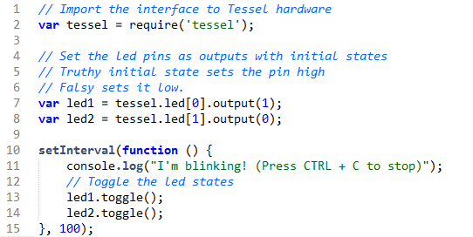
Blink on Tessel

Slide 9
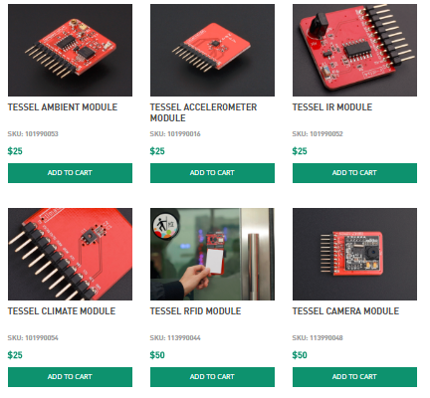
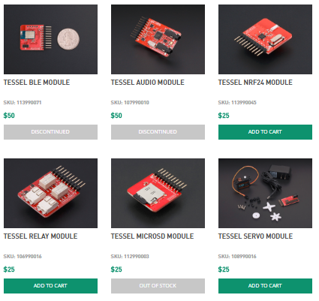
Tessel Modules - Full List (https://tessel.io/modules)

Slide 10
Hardware examples
https://www.ted.com/talks/neil_harbisson_i_listen_to_color
http://www.bbc.com/news/technology-37775605

Slide 11
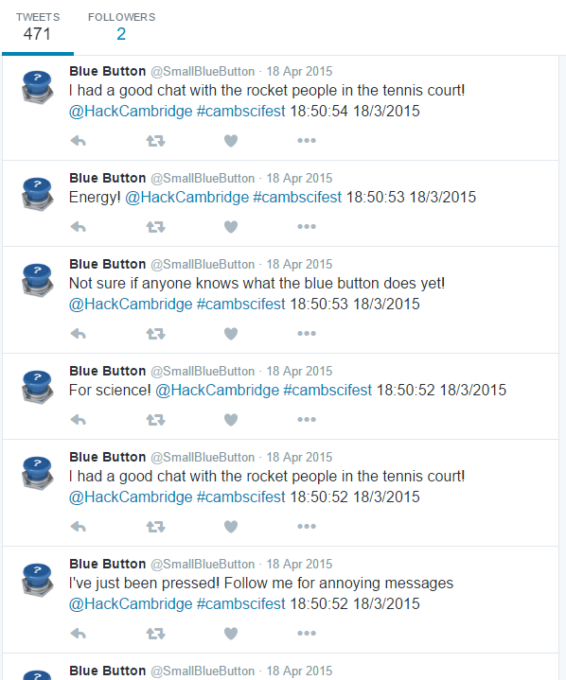
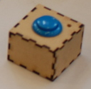
Case Study: The Blue Button
1 Button. 1 Electric Imp
Uses: Various

Slide 12
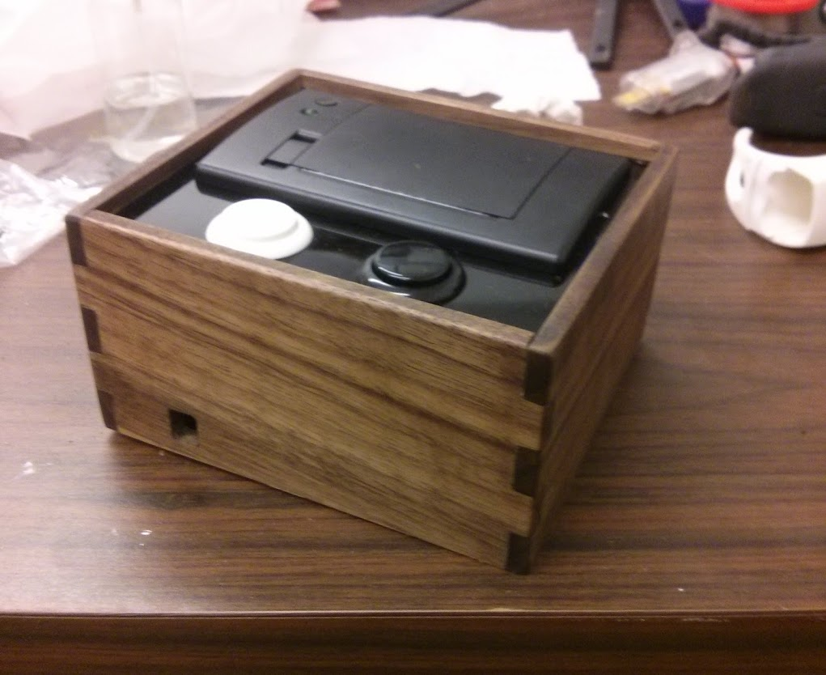
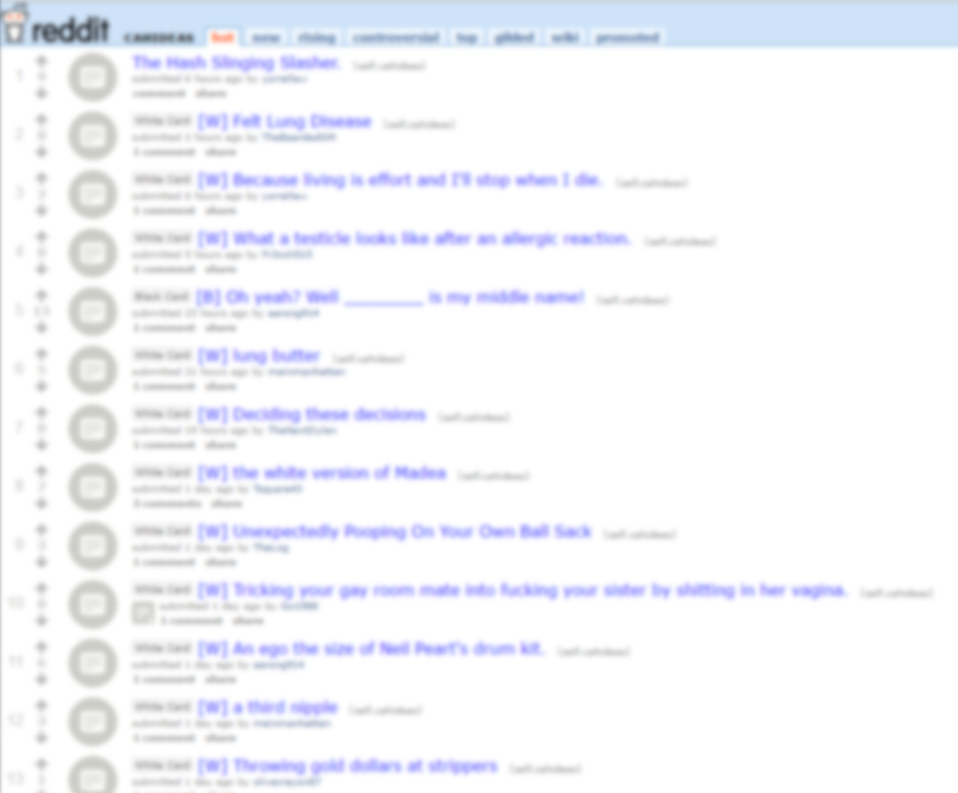
Case Study: Cards Against Humanity Printer
Electric Imp for WiFi
Thermal Printer – Receipt printer
Prints random cards from reddit
NOT SAFE FOR WORK
Reddit.com/r/cahideas

Slide 13
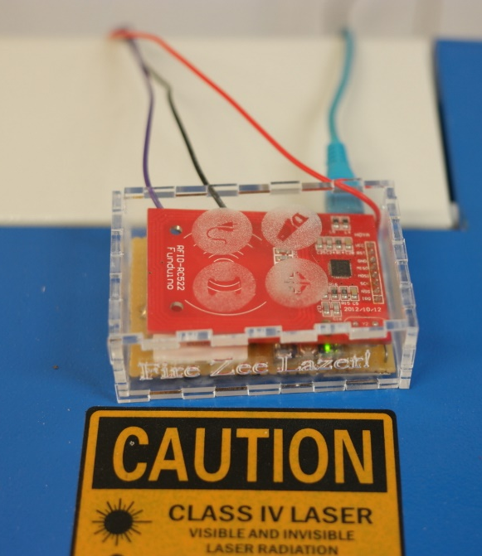
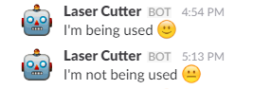
Case Study: Toolpass
System to manage access to our laser cutter
Users log in using their Charlie Card
Logs member usage for billing
Reports activity on slack
Server
User auth
Toolpass
Switch on/off
Laser Cutter
Slack Messages
Charlie Card,
Laser usage
Laser Fired

Slide 14
How do devices communicate?

Slide 15
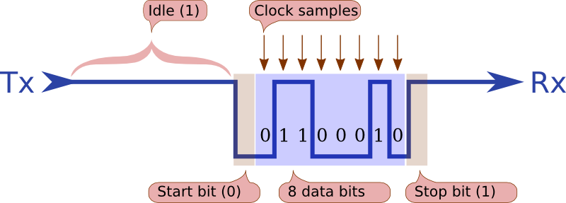
Serial Communication
Send data bit by bit
Format and transfer rate must be agreed at both ends

Slide 16
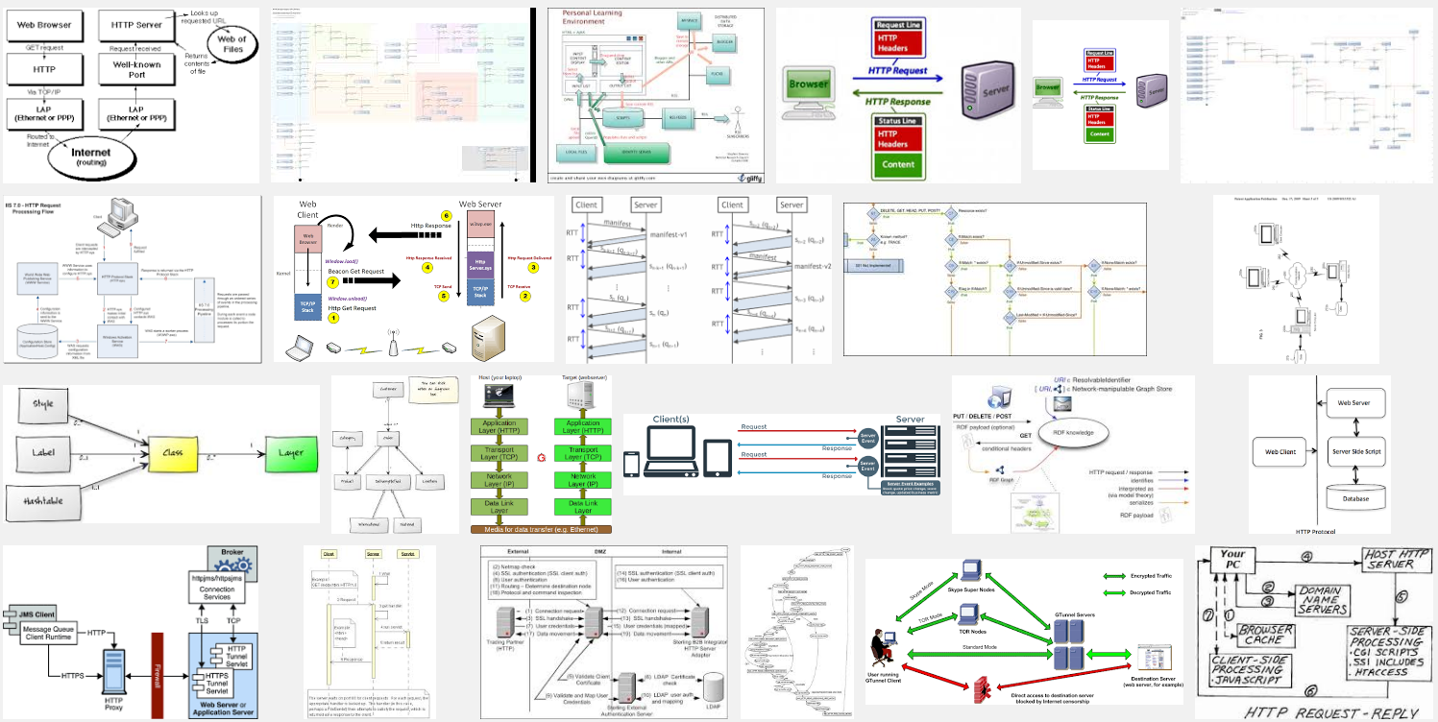
HTTP

Slide 17
HTTP: RESTful
A “request” is sent to a server via URL
Eg. http://api.example.com/resources/user/1036721?name=something
Response is usually text in HTML, XML, or JSON
Great if your asking for something
What about “push”
Eg. Server wants to tell device to do something
Path or variables
variables

Slide 18

HTTP: RESTful Hypothetical Light Switch
Cell Phone
Server
api.example.com/turnoff
api.example.com/shoulditurnoff
WiFi Switch
Should I turn off?
No
Process Response
Yes
Turn off

Slide 19
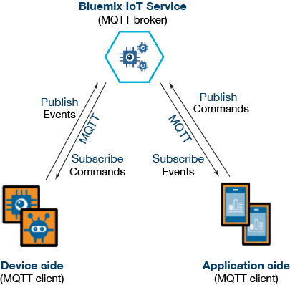
MQTT: Message Queuing Telemetry Transport

Slide 20
MQTT
MQTT was invented by Andy Stanford-Clark (IBM) and Arlen Nipper (Arcom, now Cirrus Link) back in 1999, where their use case was to create a protocol for minimal battery loss and minimal bandwidth connecting oil pipelines over satellite connection. They specified the following goals, which the future protocol should have:
Simple to implement
Provide a Quality of Service Data Delivery
Lightweight and Bandwidth Efficient
Data Agnostic
Continuous Session Awareness

Slide 21
MQTT: Pub/Sub
Clients connect to a “Broker”
Clients subscribe to topics eg,
client.subscribe(‘toggleLight/1’)
client.subscribe(‘toggleLight/2’)
client.subscribe(‘toggleLight/3’)
Clients can publish messages to topics:
client.publish(‘toggleLight/1’, ‘toggle’);
client.publish(‘toggleLight/2’, ‘toggle’);
All clients receive all messages published to topics they subscribe to
Messages can be anything
Text
Images
etc

Slide 22
MQTT Hypothetical Light Switch
Cell Phone
Broker
client.publish(‘lightSwitch/1’, ‘toggle’)
‘toggle’
WiFi Switch
Toggle Switch

Slide 23

Websockets
Chrome supports HTTP, HTTPS, FILE, FTP, WS (websockets).
Chrome does not support MQTT
But you can do MQTT over websockets!
What is websockets?

Slide 24
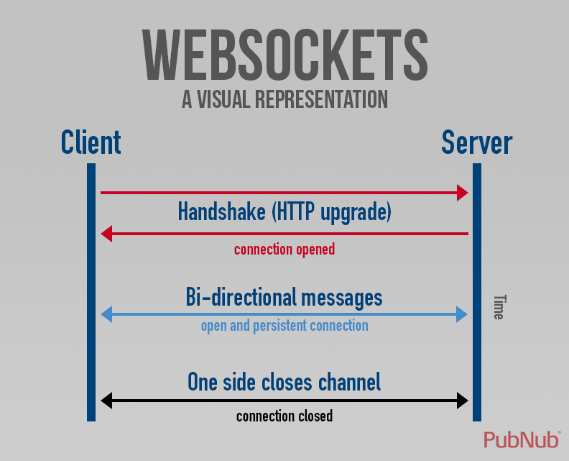
Websockets

Slide 25
Websockets
client.js
var webSocketClient = require('ws');
var ws = new webSocketClient('ws://localhost:8080');
var id = Math.floor(Math.random()*10000);
ws.on('message', function(message) {
console.log('received from %s', message);
});
function sendMessage(){
var timeStamp = Date.now();
var message = 'clientId:' + id + ', '
+ 'timeStamp:' + timeStamp;
ws.send(message);
}
function timer(){
sendMessage();
setTimeout(timer, 3000);
}
ws.on('open', function() {
timer();
});
server.js
var webSocketServer = require('ws').Server;
var wss = new webSocketServer({port: 8080});
// broadcast client message to all
wss.broadcast = function broadcast(data) {
wss.clients.forEach(function each(client) {
client.send(data);
});
};
// catch client messages
wss.on('connection', function connection(ws) {
ws.on('message', function incoming(message) {
console.log('received from %s', message);
wss.broadcast(message);
});
});

Slide 26
MQTT Over Websockets
We can still use MQTT in a browser
The connection is handled via Websockets
This eliminates a lot of the “housekeeping” required by Websockets
Many to many communication much easier

Slide 27
MQTT
client = mqtt.connect('ws://162.243.219.88', { port: 9001 });
client.on('connect', function () {
console.log('Connected to MQTT broker!’);
client.subscribe('TestChannel’);
client.publish('TestChannel', "Hello Test Channel!");
});
client.on('message', function (topic, message) {
console.log(topic);
console.log(message.toString());
});

Slide 28



MQTT in the wild

Slide 29

The Broker
IP Address: 162.243.219.88
MQTT Port: 1883 (For running in NodeJS)
Websocket Port: 9001 (For running in a web browser)
Broker is running on DigitalOcean
https://www.digitalocean.com/
Broker is Mosquitto
https://mosquitto.org/

Slide 30

Channels in MQTT
Channels/topics in MQTT work like file paths
When subscribing to a channel we have to specify the whole path
Or use a wildcard
+
#

Slide 31


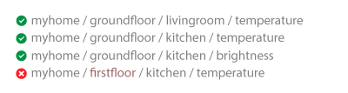
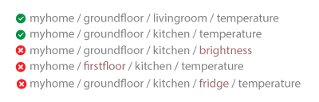
Wildcards

Slide 32
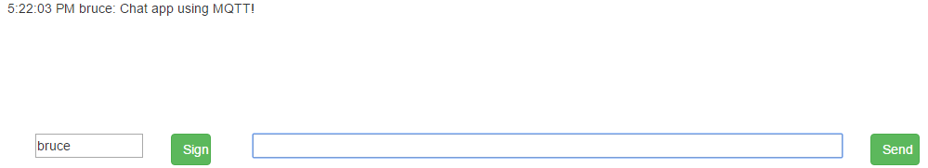
Chat with MQTT
chat.html

Slide 33
MQTT Light Switch
lightSwitch.html
Use MQTT to send a message to the device to toggle an LED
Format as JSON string
{id:”YourID”, state:true/false}
Your ID is the day of your birthday plus by 0 (male) or 32 (female)
John was born on the 27th February, his ID is 27.
Elizabeth was born on 11th May, her ID is 43
Add your code to ledMatrix.html to send the message

Slide 34
Plotting Ambient Sensor Data
Add your code to sensorData.html
Receive sensor data via MQTT
Format as a JSON string:
{date, lightLevel:data, soundLevel:data}
Plot the data live with google charts

